Slide 1
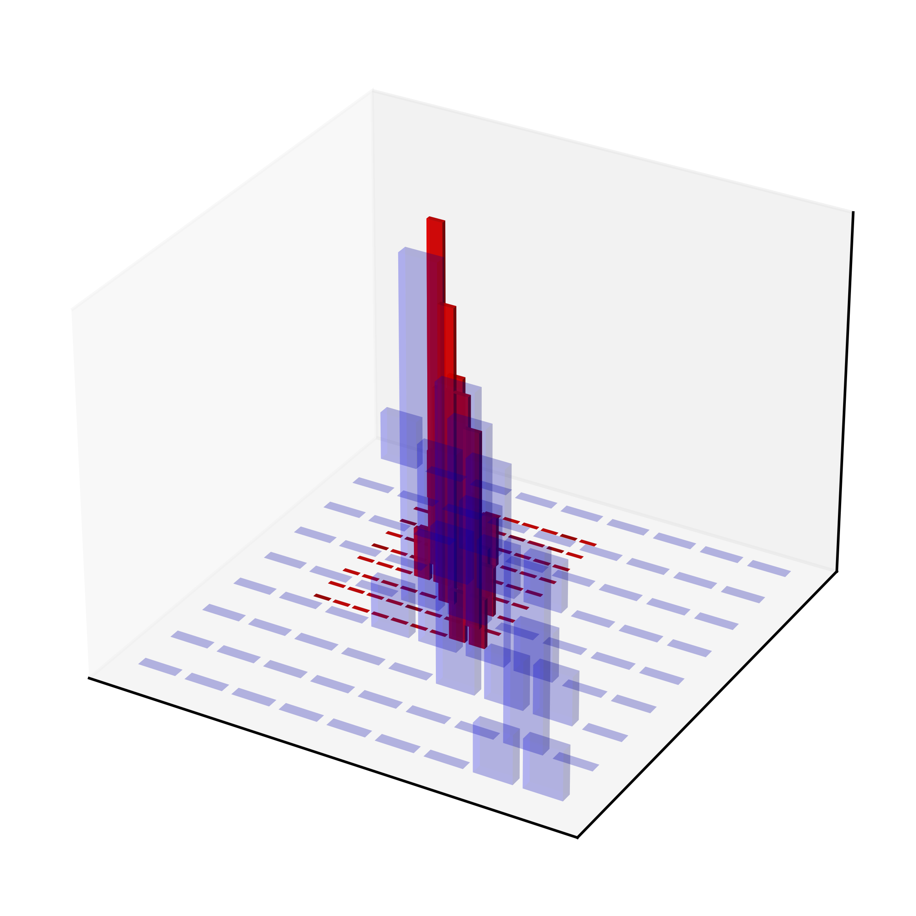


Target domain
Source domain
$$z_{2}$$
$$z_{1}$$

